Slide 1
BIG DATA ANALYTICS
Unit-2
Presented By:
Dr.R.Tamilkodi
Professor
MCA
GIET(A)
Lecture Details:
TOPIC NAME
Big Data Analytics/B.Tech,III-Year /VI-Sem.

Slide 2
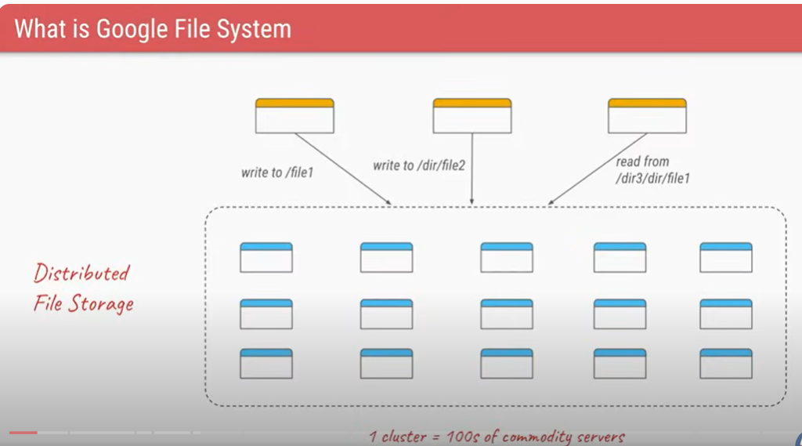

Slide 3
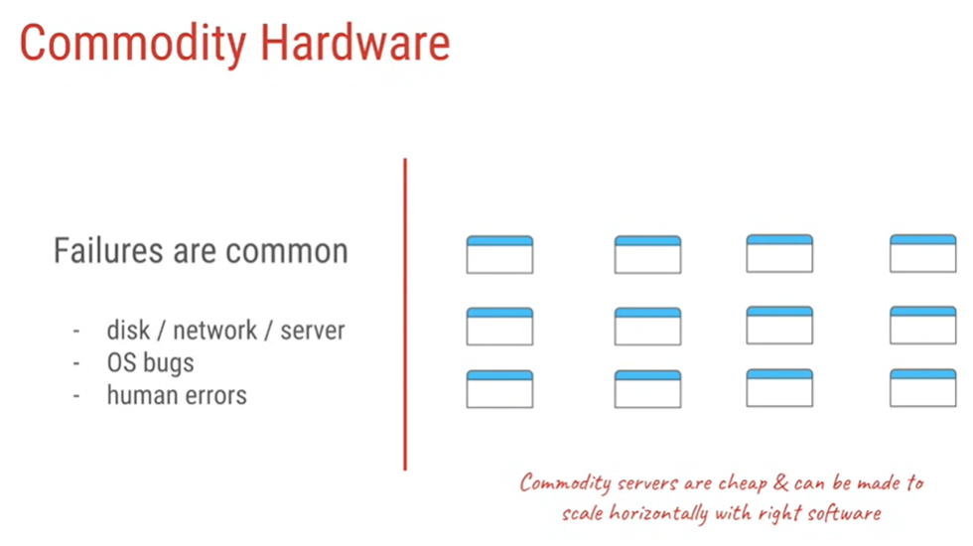

Slide 4
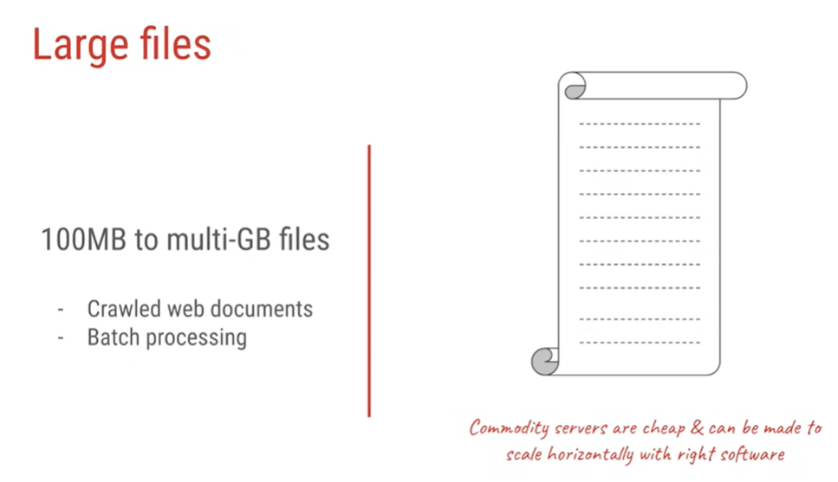

Slide 5
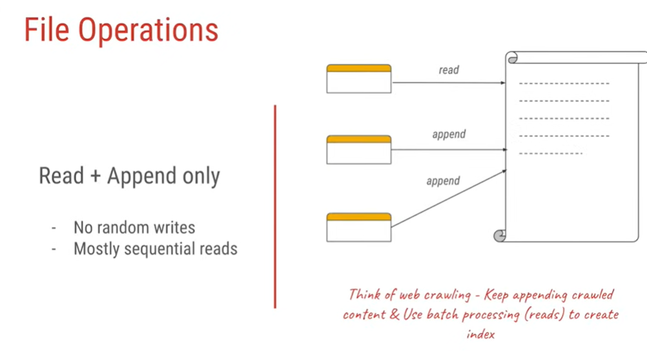

Slide 6
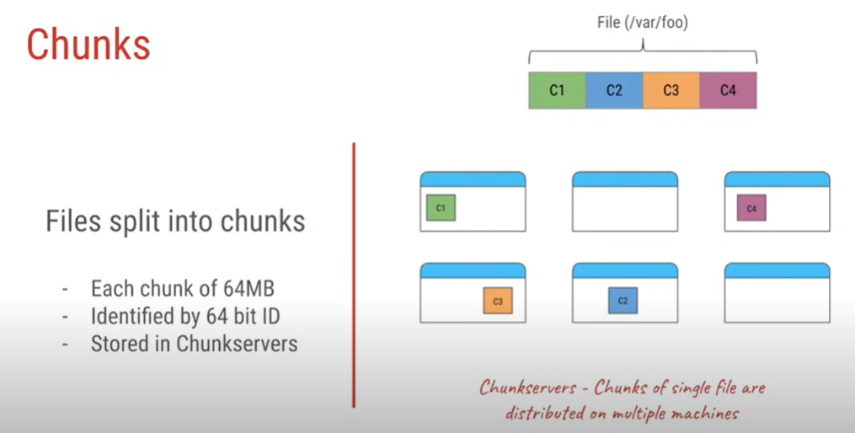

Slide 7
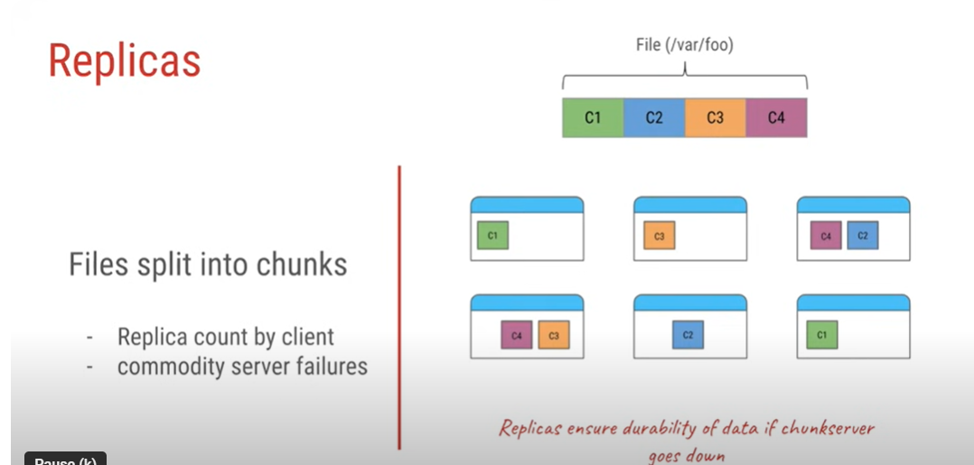

Slide 8
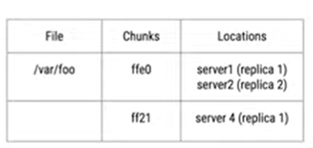
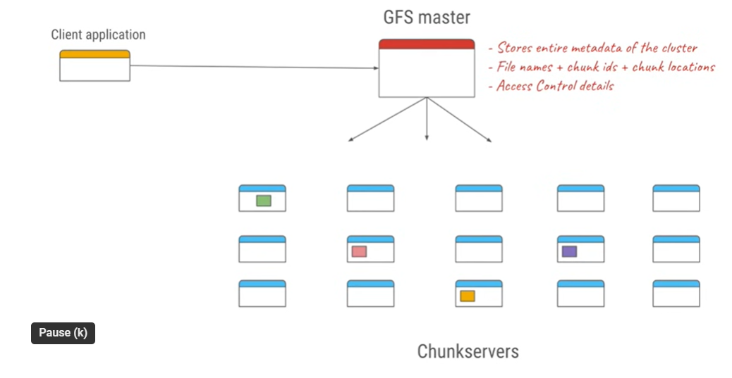



Slide 9
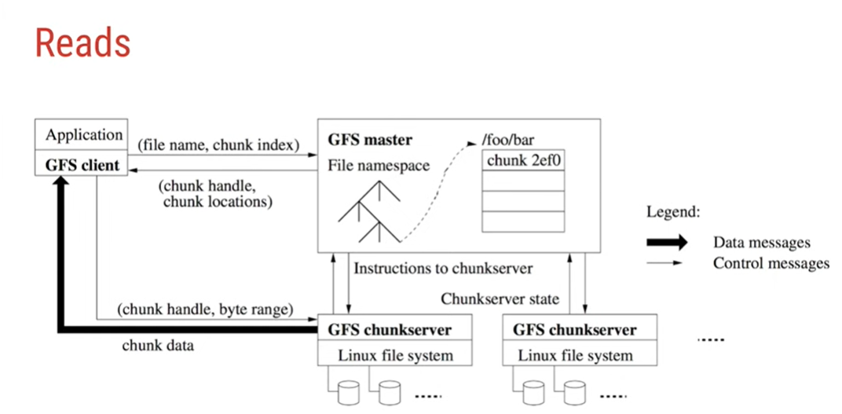

Slide 10
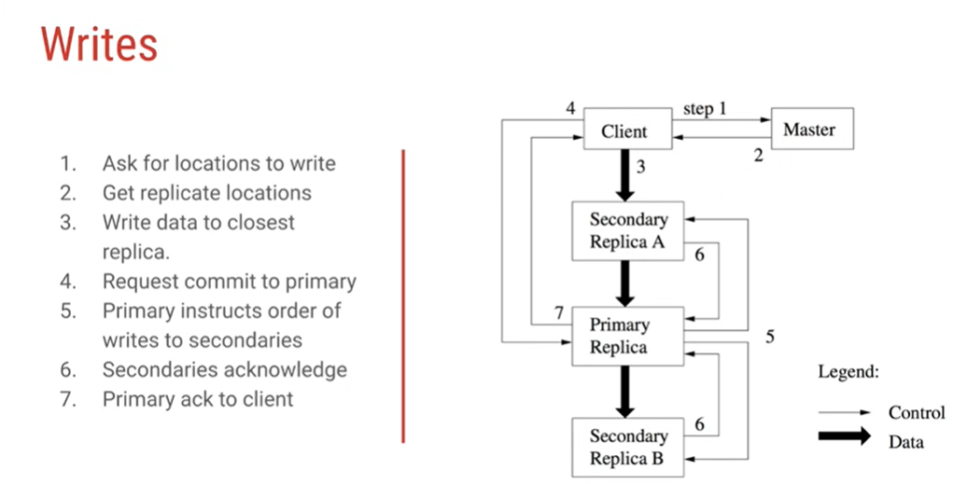

Slide 11
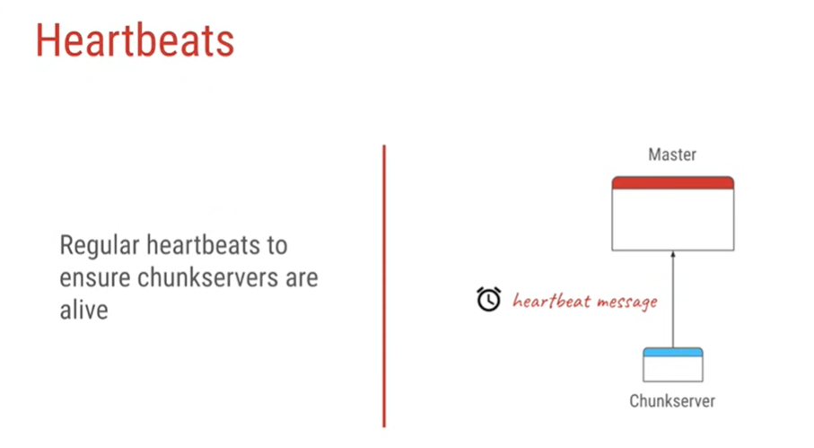

Slide 12
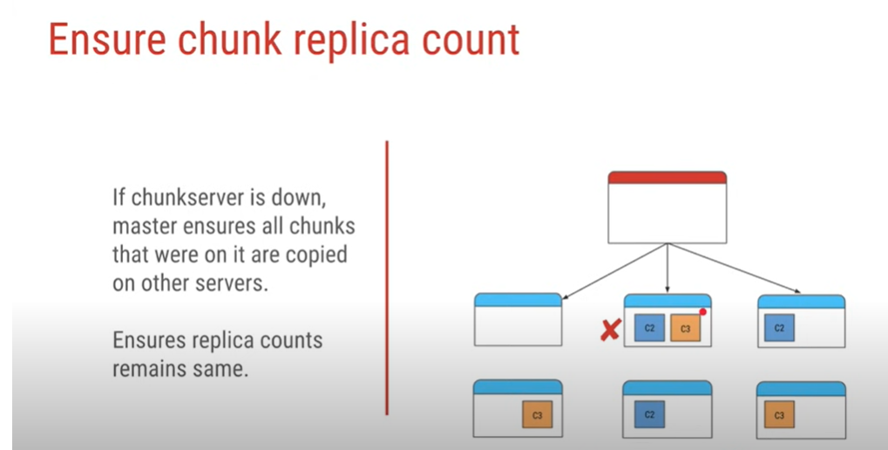

Slide 13
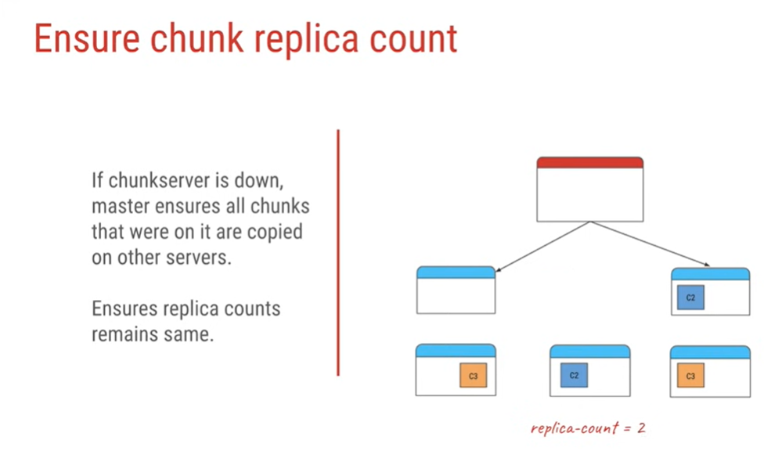

Slide 14
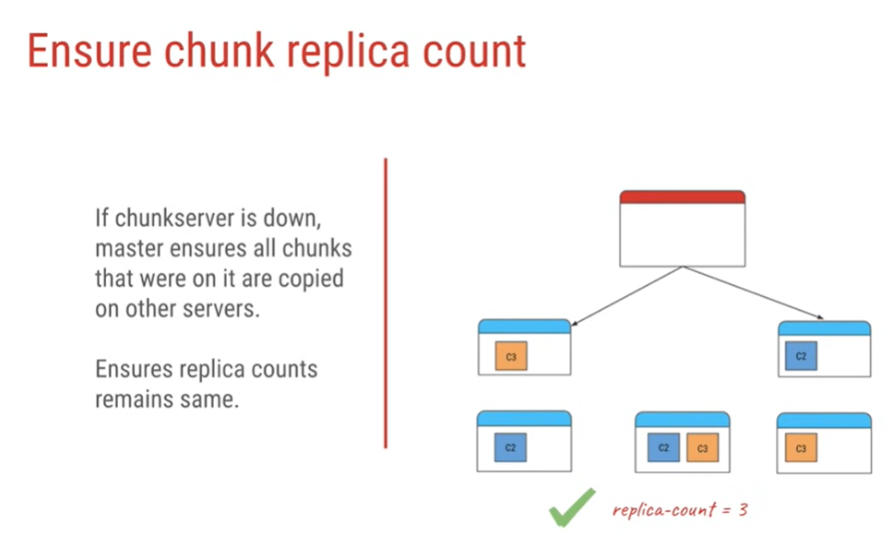

Slide 15
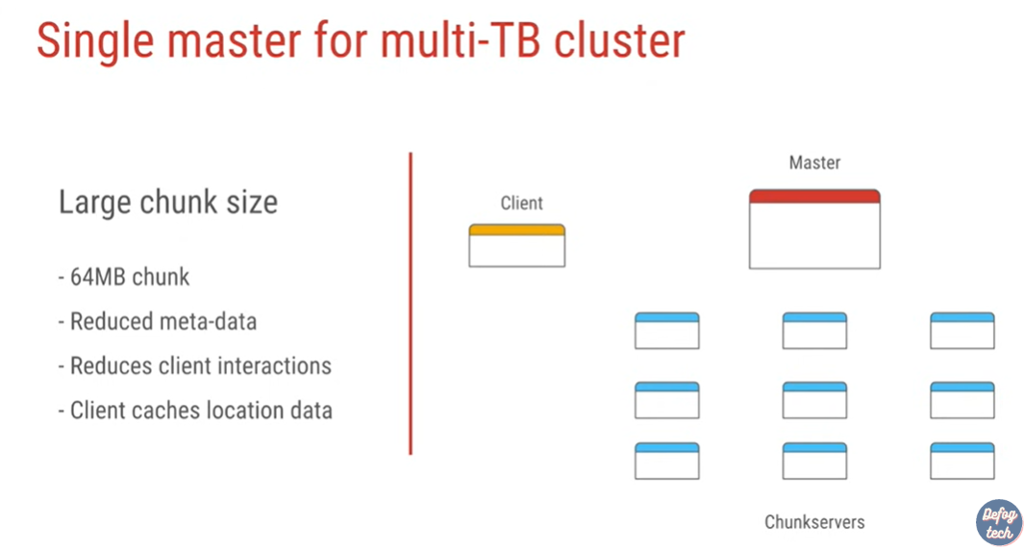


Slide 16
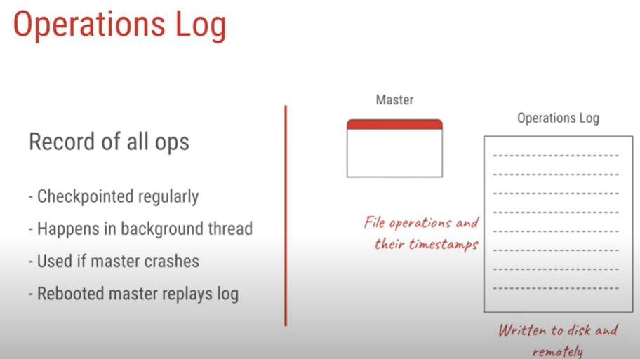

Slide 17
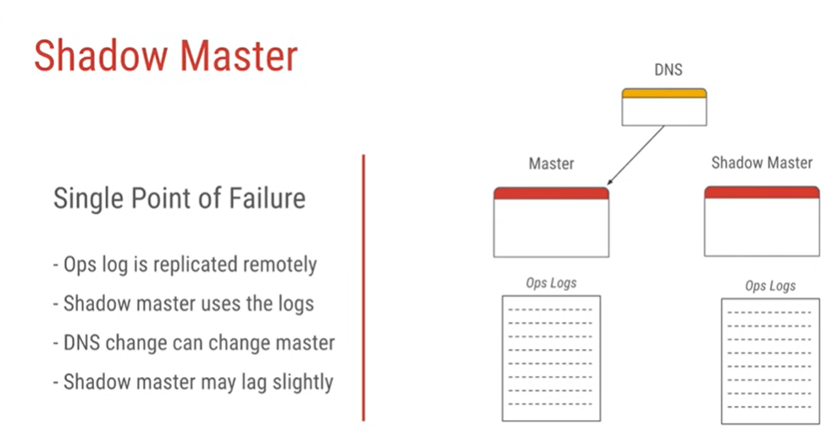

Slide 18
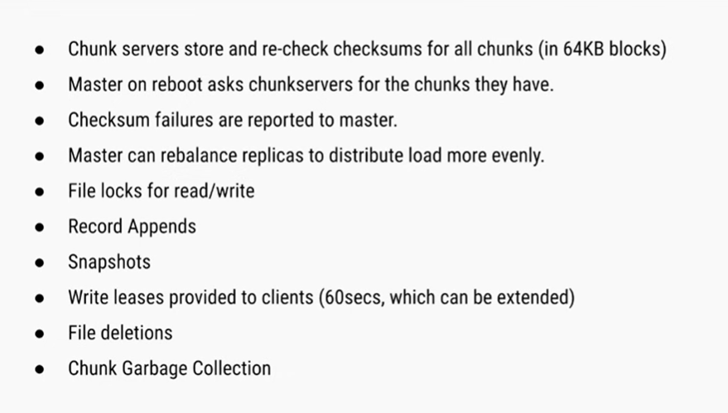
Points to Remember

Slide 19
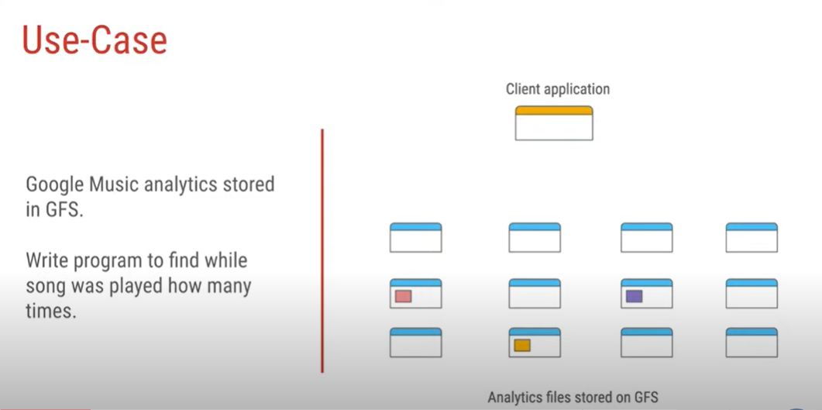

Slide 20
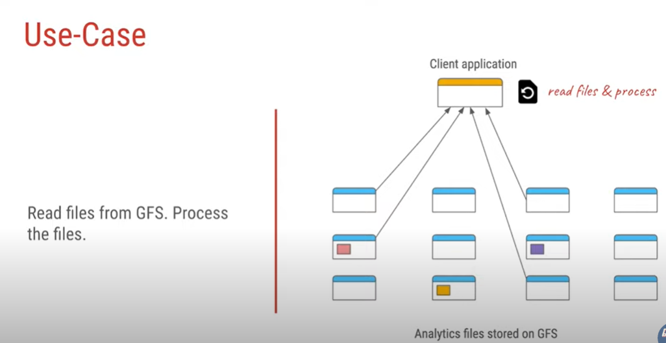

Slide 21
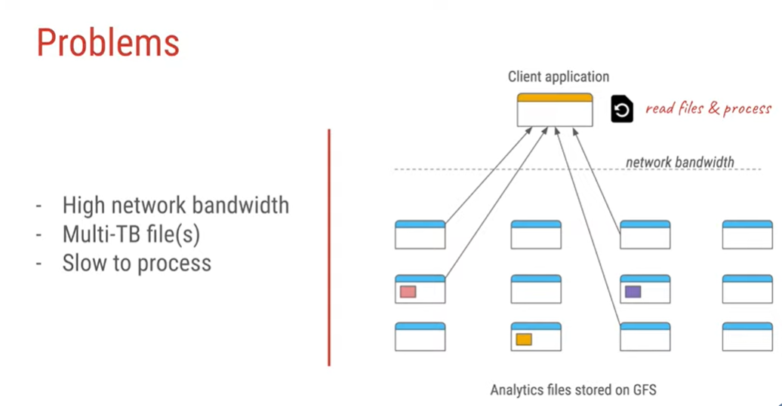

Slide 22
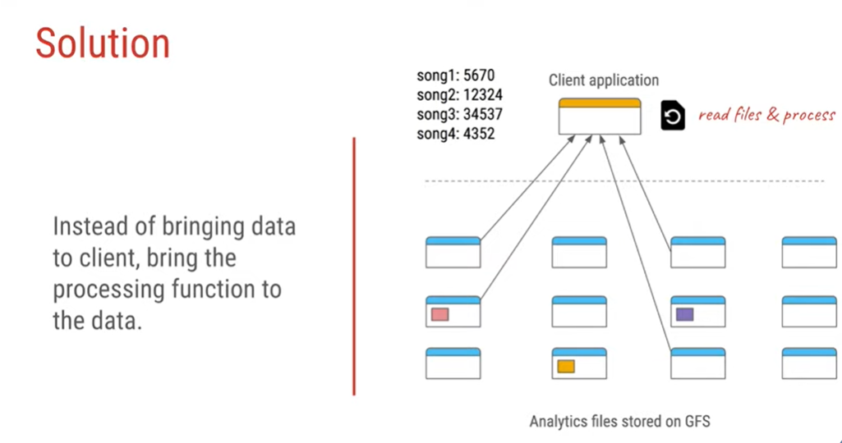

Slide 23
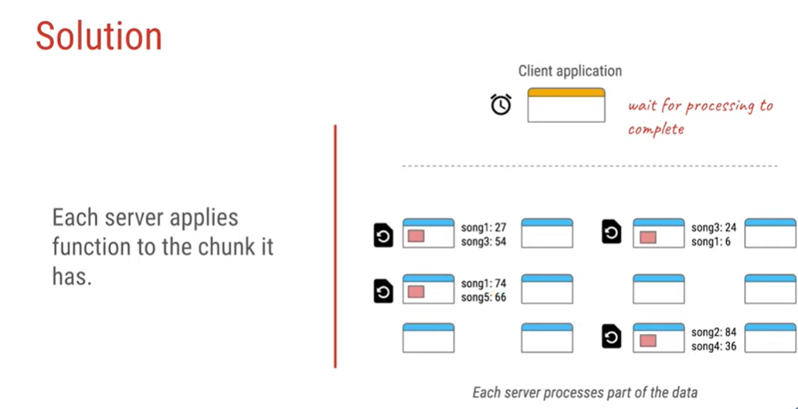

Slide 24
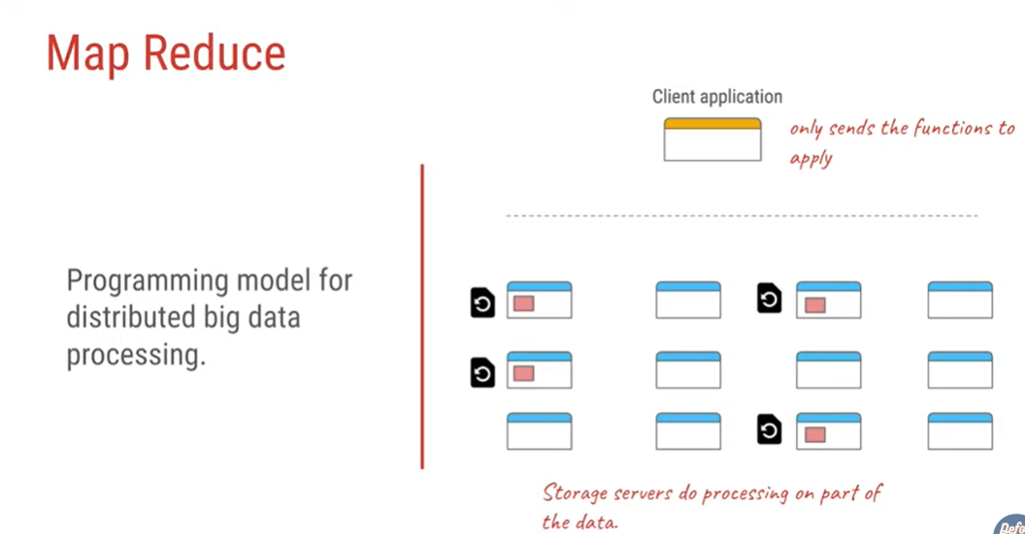

Slide 25
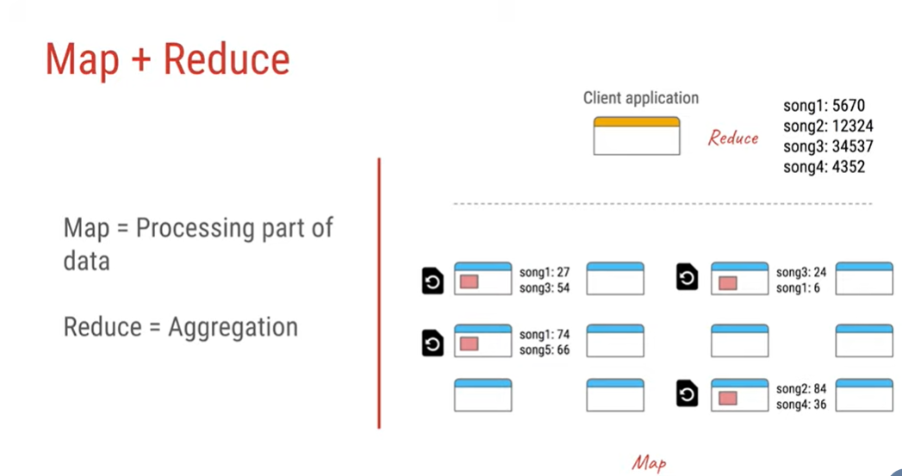

Slide 26
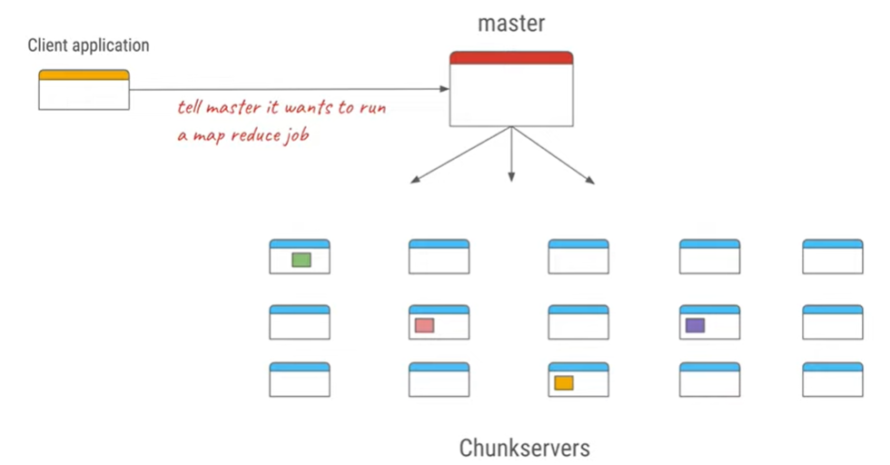

Slide 27
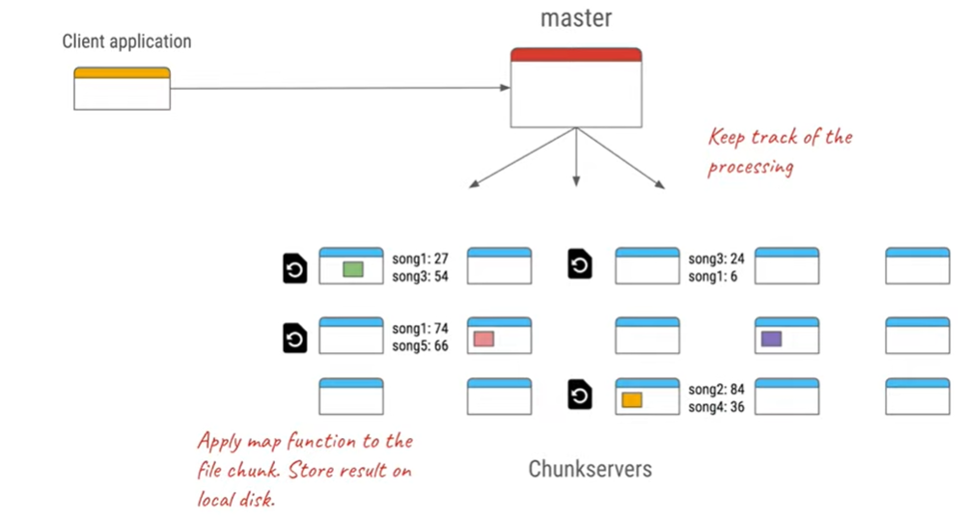

Slide 28
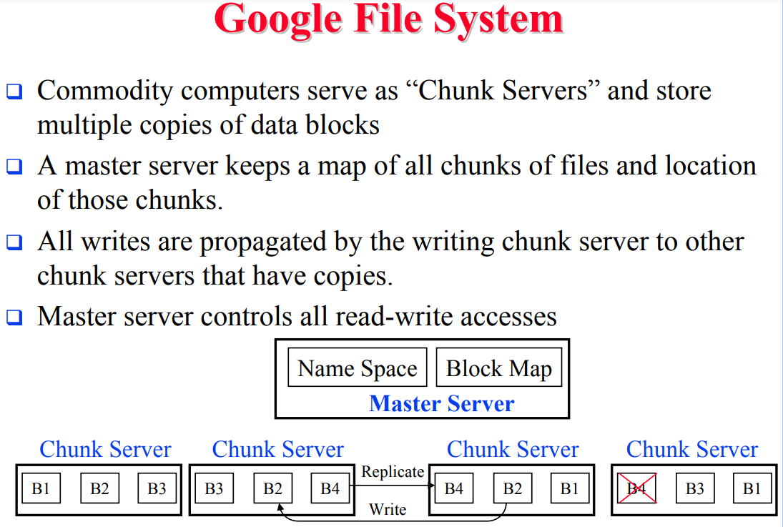

Slide 29
Google Inc. developed the Google File System (GFS), a scalable distributed file system (DFS), to meet the company’s growing data processing needs.
GFS offers fault tolerance, dependability, scalability, availability, and performance to big networks and connected nodes.
GFS is made up of a number of storage systems constructed from inexpensive commodity hardware parts.
The search engine, which creates enormous volumes of data that must be kept, is only one example of how it is customized to meet Google’s various data use and storage requirements.

Slide 30
The GFS node cluster consists of a single master and several chunk servers that various client systems regularly access.
On local discs, chunk servers keep data in the form of Linux files.
Large (64 MB) pieces of the stored data are split up and replicated at least three times around the network.
Reduced network overhead results from the greater chunk size.

Slide 31
The master is in charge of managing metadata, including namespace, access control, and mapping data.
The master communicates with each chunk server by timed heartbeat messages and keeps track of its status updates.
More than 1,000 nodes with 300 TB of disc storage capacity make up the largest GFS clusters.
This is available for constant access by hundreds of clients.

Slide 32
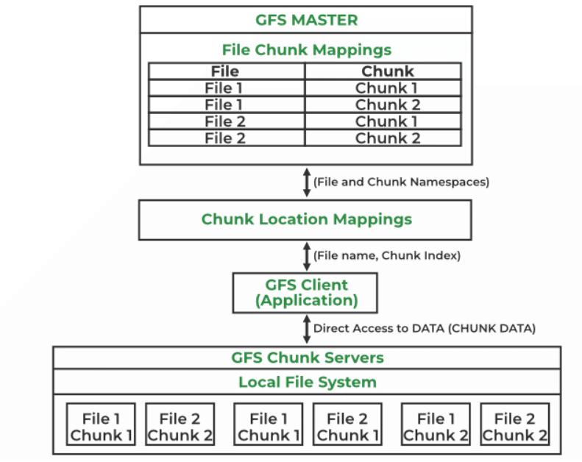

Slide 33
Components of GFS
A group of computers makes up GFS. A cluster is just a group of connected computers.
There could be hundreds or even thousands of computers in each cluster.
There are three basic entities included in any GFS cluster as follows:
GFS Clients: They can be computer programs or applications which may be used to request files.
Requests may be made to access and modify already-existing files or add new files to the system.
GFS Master Server: It serves as the cluster’s coordinator. It preserves a record of the cluster’s actions in an operation log.
Additionally, it keeps track of the data that describes chunks, or metadata. The chunks’ place in the overall file and which files they belong to are indicated by the metadata to the master server.
GFS Chunk Servers: They are the GFS’s workhorses. They keep 64 MB-sized file chunks.
The master server does not receive any chunks from the chunk servers. Instead, they directly deliver the client the desired chunks.
The GFS makes numerous copies of each chunk and stores them on various chunk servers in order to assure stability; the default is three copies. Every replica is referred to as one.

Slide 34
Features of GFS
Namespace management and locking
Fault tolerance
Reduced client and master interaction because of large chunk server size
High availability
Critical data replication
Automatic and efficient data recovery
High aggregate throughput
Advantages of GFS
High accessibility Data is still accessible even if a few nodes fail. (replication) Component failures are more common than not, as the saying goes
Excessive throughput. many nodes operating concurrently.
Dependable storing. Data that has been corrupted can be found and duplicated

Slide 35


Slide 36
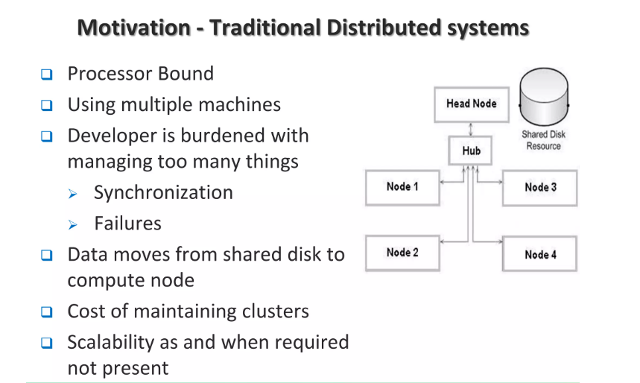

Slide 37
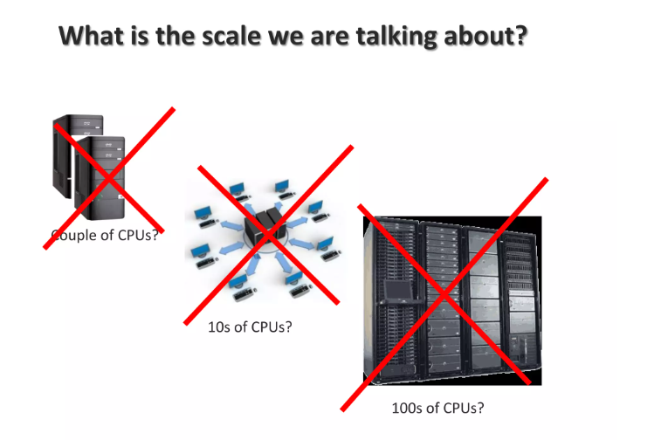

Slide 38
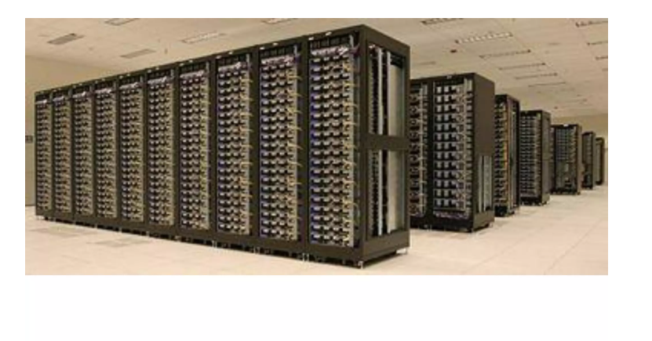

Slide 39
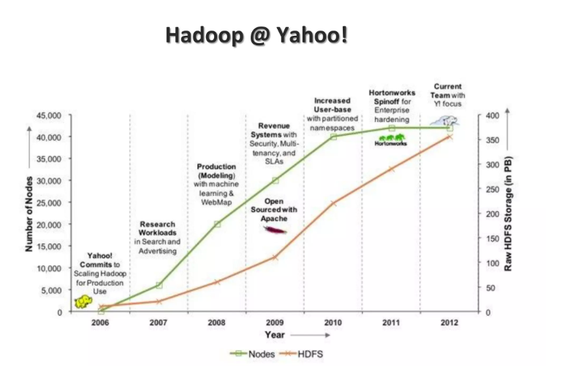

Slide 40
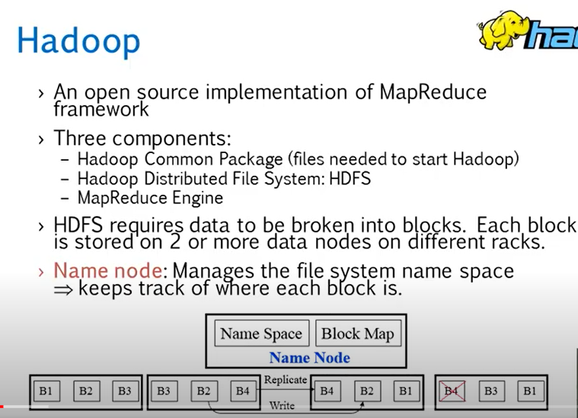

Slide 41
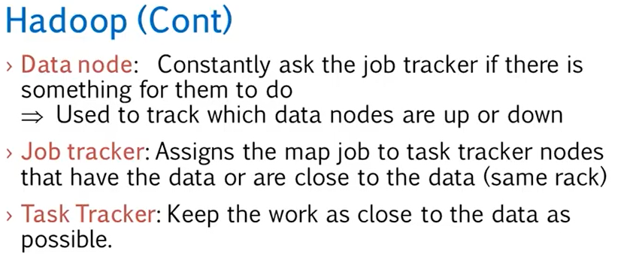
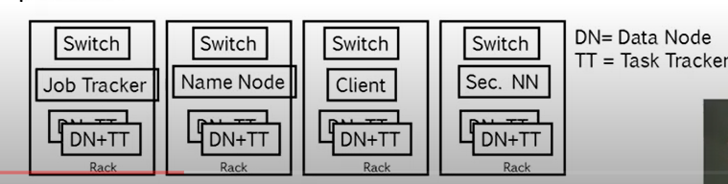
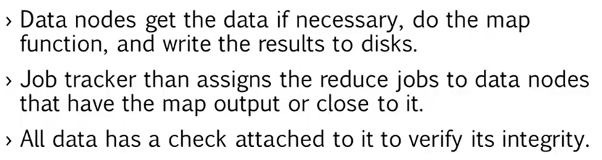

Slide 42
Hadoop Distributed File System (HDFS)
HDFS is a distributed file system that handles large data sets running on commodity hardware.
It is used to scale a single Apache Hadoop cluster to hundreds (and even thousands) of nodes.
HDFS is one of the major components of Apache Hadoop, the others being MapReduce and YARN.
HDFS should not be confused with or replaced by Apache HBase, which is a column-oriented non-relational database management system that sits on top of HDFS and can better support real-time data needs with its in-memory processing engine.

Slide 43
An example of HDFS
Consider a file that includes the phone numbers for everyone in the United States; the numbers for people with a last name starting with A might be stored on server 1, B on server 2, and so on.
With Hadoop, pieces of this phonebook would be stored across the cluster, and to reconstruct the entire phonebook, your program would need the blocks from every server in the cluster.
To ensure availability if and when a server fails, HDFS replicates these smaller pieces onto two additional servers by default.
(The redundancy can be increased or decreased on a per-file basis or for a whole environment; for example, a development Hadoop cluster typically doesn’t need any data redundancy.)
This redundancy offers multiple benefits, the most obvious being higher availability.
The redundancy also allows the Hadoop cluster to break up work into smaller chunks and run those jobs on all the servers in the cluster for better scalability.
Finally, you gain the benefit of data locality, which is critical when working with large data sets.

Slide 44
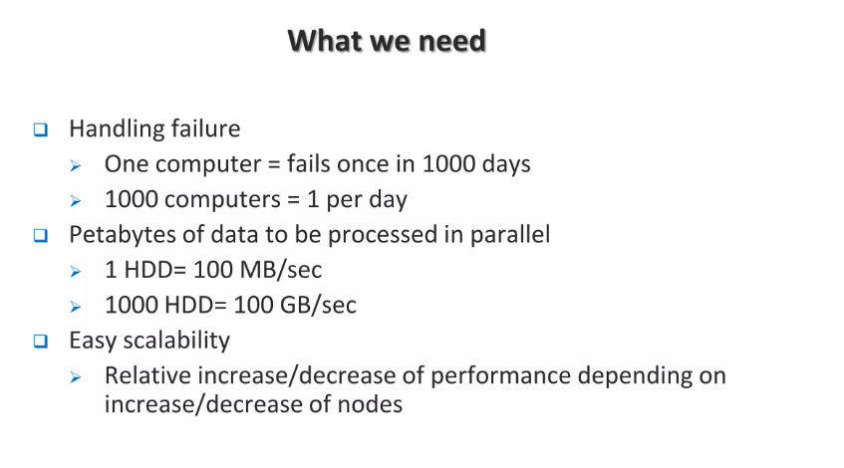

Slide 45


Slide 46
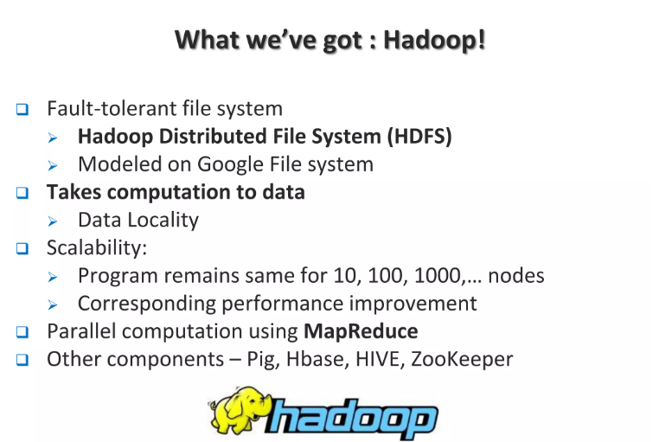

Slide 47
Nodes: Master-slave nodes typically forms the HDFS cluster.
NameNode(MasterNode):
Manages all the slave nodes and assign work to them.
It executes filesystem namespace operations like opening, closing, renaming files and directories.
It should be deployed on reliable hardware which has the high config. not on commodity hardware.
DataNode(SlaveNode):
Actual worker nodes, who do the actual work like reading, writing, processing etc.
They also perform creation, deletion, and replication upon instruction from the master.
They can be deployed on commodity hardware.

Slide 48
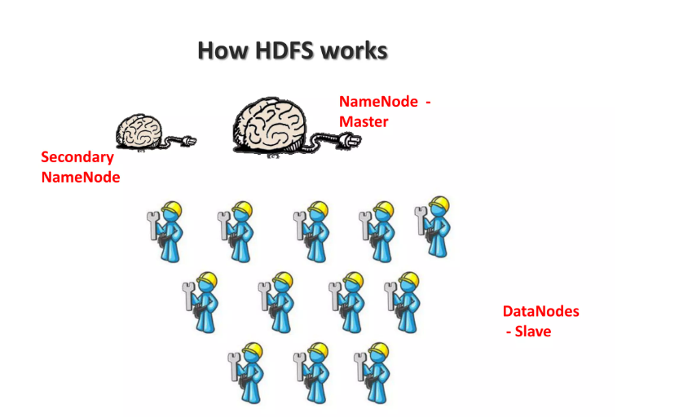

Slide 49
Secondary NameNode
The secondary NameNode server is responsible for maintaining a copy of the metadata in the disk. The main purpose of the secondary NameNode is to create a new NameNode in case of failure.
In a high availability cluster, there are two NameNodes: active and standby. The secondary NameNode performs a similar function to the standby NameNode.

Slide 50
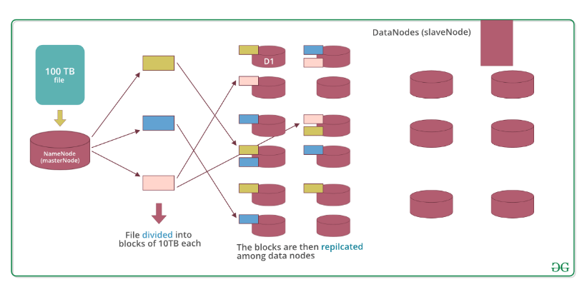
Data storage in HDFS: Now let’s see how the data is stored in a distributed manner.

Slide 51
Lets assume that 100TB file is inserted, then masternode(namenode) will first divide the file into blocks of 10TB (default size is 128 MB in Hadoop 2.x and above).
Then these blocks are stored across different datanodes(slavenode). Datanodes(slavenode)replicate the blocks among themselves and the information of what blocks they contain is sent to the master.
Default replication factor is 3 means for each block 3 replicas are created (including itself).
Note: MasterNode has the record of everything, it knows the location and info of each and every single data nodes and the blocks they contain, i.e. nothing is done without the permission of masternode.

Slide 52
Why divide the file into blocks?
Let’s assume that we don’t divide, now it’s very difficult to store a 100 TB file on a single machine.
Even if we store, then each read and write operation on that whole file is going to take very high seek time.
But if we have multiple blocks of size 128MB then its become easy to perform various read and write operations on it compared to doing it on a whole file at once.
So we divide the file to have faster data access i.e. reduce seek time.

Slide 53
Why replicate the blocks in data nodes while storing?
Let’s assume we don’t replicate and only one yellow block is present on datanode D1.
Now if the data node D1 crashes we will lose the block and which will make the overall data inconsistent and faulty.
So we replicate the blocks to achieve fault-tolerance.

Slide 54
Terms related to HDFS
HeartBeat : It is the signal that datanode continuously sends to namenode.
If namenode doesn’t receive heartbeat from a datanode then it will consider it dead.
Balancing : If a datanode is crashed the blocks present on it will be gone too and the blocks will be under-replicated compared to the remaining blocks.
Here master node(namenode) will give a signal to datanodes containing replicas of those lost blocks to replicate so that overall distribution of blocks is balanced.
Replication:: It is done by datanode.
Note: No two replicas of the same block are present on the same datanode.

Slide 55
Features:
Distributed data storage.
Blocks reduce seek time.
The data is highly available as the same block is present at multiple datanodes.
Even if multiple datanodes are down we can still do our work, thus making it highly reliable.
High fault tolerance.

Slide 56
Limitations: Though HDFS provide many features there are some areas where it doesn’t work well.
Low latency data access: Applications that require low-latency access to data i.e in the range of milliseconds will not work well with HDFS, because HDFS is designed keeping in mind that we need high-throughput of data even at the cost of latency.
Small file problem: Having lots of small files will result in lots of seeks and lots of movement from one datanode to another datanode to retrieve each small file, this whole process is a very inefficient data access pattern.

Slide 57
Why Hadoop
Hadoop makes it easier to use all the storage and processing capacity in cluster servers, and to execute distributed processes against huge amounts of data.
Hadoop provides the building blocks on which other services and applications can be built.

Slide 58


Slide 59

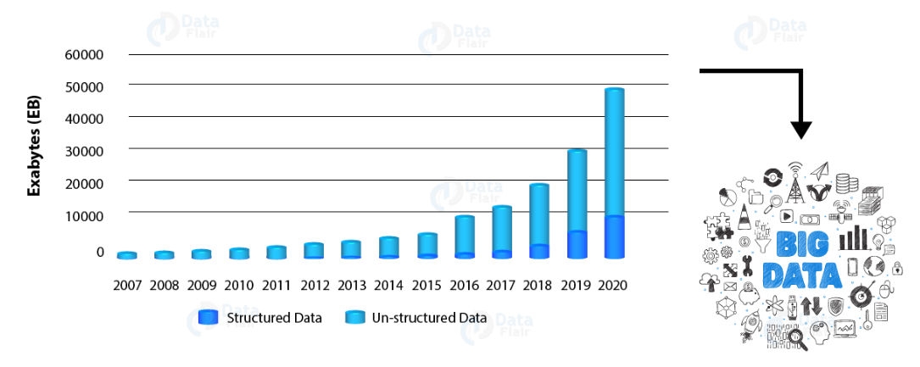
1. Managing Big Data
As we are living in the digital era there is a data explosion.
The data is getting generated at a very high speed and high volume. So there is an increasing need to manage this Big Data.

Slide 60
2. Exponential Growth of Big Data Market
“Hadoop Market is expected to reach $99.31B by 2022 at a CAGR of 42.1%”
Slowly companies are realizing the advantage big data can bring to their business.
The big data analytics sector in India will grow eightfold. As per NASSCOM, it will reach USD 16 billion by 2025 from USD 2 billion.
As India progresses, there is penetration of smart devices in cities and in villages. This will scale up the big data market.

Slide 61


Slide 62
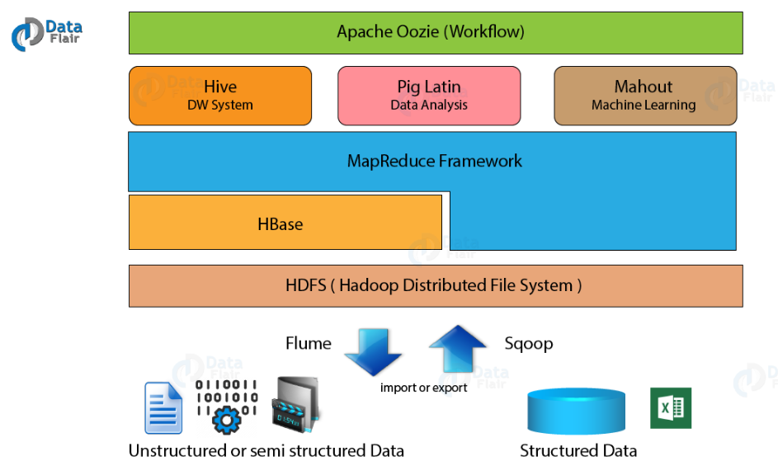
5. Robust Hadoop Ecosystem
Hadoop has a very robust and rich ecosystem which serves a wide variety of organizations.
Organizations like web start-ups, telecom, financial and so on are needing Hadoop to answer their business needs.

Slide 63
6. Research Tool
Hadoop has come up as a powerful research tool. It allows an organization to find answers to their business questions.
Hadoop helps them in research and development work.
Companies use it to perform the analysis. They use this analysis to develop a rapport with the customer.

Slide 64
7. Ease of Use
Creators of Hadoop have written it in Java, which has the biggest developer community.
Therefore, it is easy to adapt by programmers. You can have the flexibility of programming in other languages too like C, C++, Python, Perl, Ruby etc.
If you are familiar with SQL, it is easy to use HIVE. If you are ok with scripting then PIG is for you.

Slide 65


Slide 66
9. Higher Salaries
In the current scenario, there is a gap between demand and supply of Big Data professional. This gap is increasing every day.
According to IBM, demand for US data professionals will reach to 364000 by 2020. In the wake of the scarcity of Hadoop professionals, organizations are ready to offer big packages for Hadoop skills.
As per indeed, the average salary for Hadoop skill is $112,000 per annum.
It is 95% higher than the average salaries for all other job postings.
There is always a compelling requirement of skilled people who can think from a business point of view.
They are the people who understand data and can produce insights with that data. For this reason, technical persons with analytics skills find them in great demand.

Slide 67
10. A Maturing Technology
Hadoop is evolving with time. The new version of Hadoop i.e. Hadoop 3.0 is coming into the market.
It has already collaborated with HortonWorks, Tableau, MapR, and even BI experts to name a few.
New actors like Spark, Flink etc. are coming on the Big Data stage.
These technologies promise the lightening speed of processing.
These technologies also provide a single platform for various kinds of workloads.
It is compatible with these new players. It provides robust data storage over which we can deploy technologies like Spark and Flink.

Slide 68
11. Hadoop has a Better Career Scope
Hadoop excels in processing a wide variety of data.
We have various components of Hadoop ecosystem providing batch processing, stream processing, machine learning and so on.
Learning it will open gates to a variety of job roles like:
Big Data Architect
Hadoop Developer
Data Scientist
Hadoop Administrator
Data Analyst

Slide 69
Scale-out storage is a network-attached storage (NAS) architecture in which the total amount of disk space can be expanded through the addition of devices in connected arrays with their own resources.
In a scale-out system, new hardware can be added and configured as the need arises.
When a scale-out system reaches its storage limit, another array can be added to expand the system capacity.
Scale-out storage can harness the extra storage added across arrays and use added devices to increase network storage capacity, adding performance and addressing the need for additional storage.

Slide 70
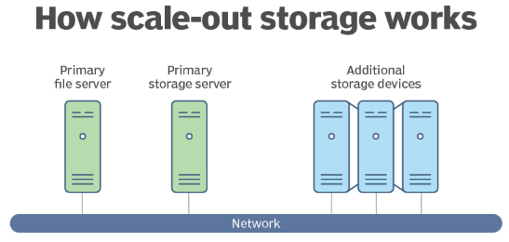
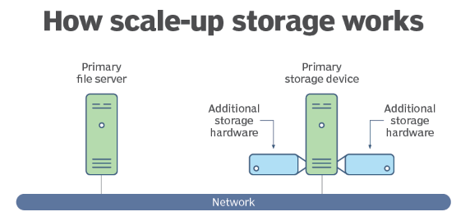
Scale-out storage
Scale-out storage, or horizontal scalability, is the ability to connect multiple storage elements, such as storage arrays, so that they work as a single logical unit. With scale-out storage, there can be many geographically separated nodes.

Slide 71
Difference Between RDBMS and Hadoop
RDMS (Relational Database Management System): RDBMS is an information management system, which is based on a data model.
In RDBMS tables are used for information storage.
Each row of the table represents a record and column represents an attribute of data.
Organization of data and their manipulation processes are different in RDBMS from other databases.
RDBMS ensures ACID (atomicity, consistency, integrity, durability) properties required for designing a database.
The purpose of RDBMS is to store, manage, and retrieve data as quickly and reliably as possible.

Slide 72
Hadoop: It is an open-source software framework used for storing data and running applications on a group of commodity hardware.
It has large storage capacity and high processing power.
It can manage multiple concurrent processes at the same time.
It is used in predictive analysis, data mining and machine learning.
It can handle both structured and unstructured form of data.
It is more flexible in storing, processing, and managing data than traditional RDBMS.
Unlike traditional systems, Hadoop enables multiple analytical processes on the same data at the same time.
It supports scalability very flexibly.

Slide 73
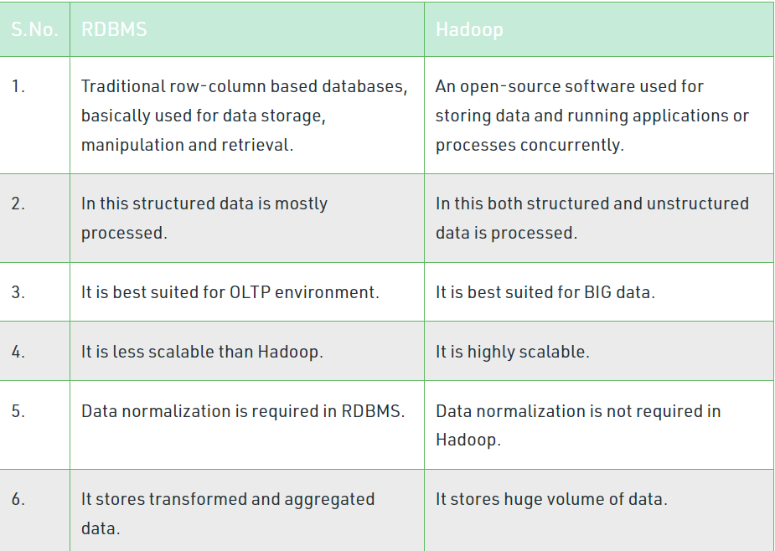

Slide 74
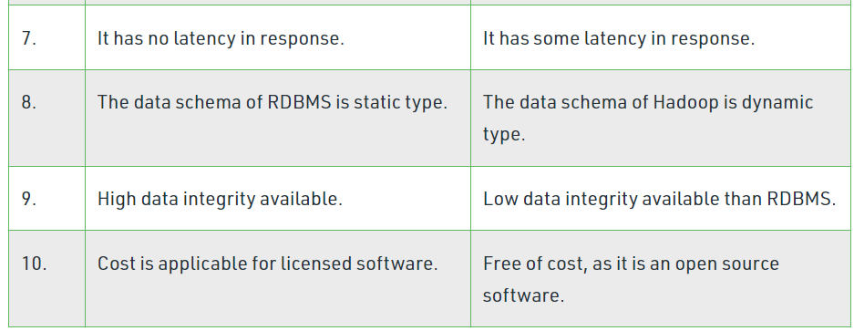

Slide 75
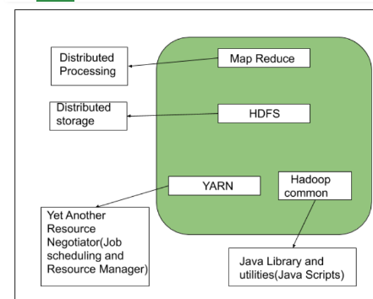
The Hadoop Architecture Mainly consists of 4 components.
MapReduce
HDFS(Hadoop Distributed File System)
YARN(Yet Another Resource Negotiator)
Common Utilities or Hadoop Common

Slide 76
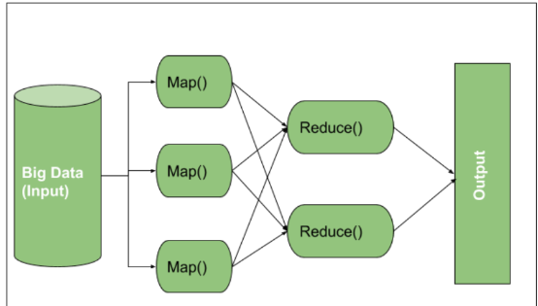
MapReduce
An algorithm or a data structure that is based on the YARN framework. The major feature of MapReduce is to perform the distributed processing in parallel in a Hadoop cluster which Makes Hadoop working so fast. When you are dealing with Big Data, serial processing is no more of any use. MapReduce has mainly 2 tasks which are divided phase-wise:
In first phase, Map is utilized and in next phase Reduce is utilized.

Slide 77
Input is provided to the Map() function then it’s output is used as an input to the Reduce function and after that, we receive our final output. Let’s understand What this Map() and Reduce() does.
As we can see that an Input is provided to the Map(), now as we are using Big Data. The Input is a set of Data. The Map() function here breaks this DataBlocks into Tuples that are nothing but a key-value pair. These key-value pairs are now sent as input to the Reduce().
The Reduce() function then combines this broken Tuples or key-value pair based on its Key value and form set of Tuples, and perform some operation like sorting, summation type job, etc. which is then sent to the final Output Node. Finally, the Output is Obtained.
The data processing is always done in Reducer depending upon the business requirement of that industry. This is How First Map() and then Reduce is utilized one by one.

Slide 78
Map Task:
RecordReader The purpose of recordreader is to break the records. It is responsible for providing key-value pairs in a Map() function. The key is actually is its locational information and value is the data associated with it.
Map: A map is nothing but a user-defined function whose work is to process the Tuples obtained from record reader. The Map() function either does not generate any key-value pair or generate multiple pairs of these tuples.
Combiner: Combiner is used for grouping the data in the Map workflow. It is similar to a Local reducer. The intermediate key-value that are generated in the Map is combined with the help of this combiner. Using a combiner is not necessary as it is optional.
Partitionar: Partitional is responsible for fetching key-value pairs generated in the Mapper Phases. The partitioner generates the shards corresponding to each reducer. Hashcode of each key is also fetched by this partition. Then partitioner performs it’s(Hashcode) modulus with the number of reducers(key.hashcode()%(number of reducers)).

Slide 79
Reduce Task
Shuffle and Sort: The Task of Reducer starts with this step, the process in which the Mapper generates the intermediate key-value and transfers them to the Reducer task is known as Shuffling. Using the Shuffling process the system can sort the data using its key value. Once some of the Mapping tasks are done Shuffling begins that is why it is a faster process and does not wait for the completion of the task performed by Mapper.
Reduce: The main function or task of the Reduce is to gather the Tuple generated from Map and then perform some sorting and aggregation sort of process on those key-value depending on its key element.
OutputFormat: Once all the operations are performed, the key-value pairs are written into the file with the help of record writer, each record in a new line, and the key and value in a space-separated manner.

Slide 80
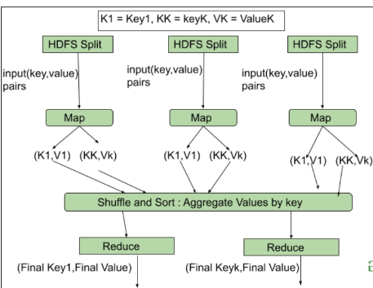

Slide 81
2. HDFS
HDFS(Hadoop Distributed File System) is utilized for storage permission. It is mainly designed for working on commodity Hardware devices(inexpensive devices), working on a distributed file system design.
HDFS is designed in such a way that it believes more in storing the data in a large chunk of blocks rather than storing small data blocks.
HDFS in Hadoop provides Fault-tolerance and High availability to the storage layer and the other devices present in that Hadoop cluster. Data storage Nodes in HDFS.
NameNode(Master)
DataNode(Slave)

Slide 82
NameNode:NameNode works as a Master in a Hadoop cluster that guides the Datanode(Slaves).
Namenode is mainly used for storing the Metadata i.e. the data about the data.
Meta Data can be the transaction logs that keep track of the user’s activity in a Hadoop cluster.
Meta Data can also be the name of the file, size, and the information about the location(Block number, Block ids) of Datanode that Namenode stores to find the closest DataNode for Faster Communication.
Namenode instructs the DataNodes with the operation like delete, create, Replicate, etc.

Slide 83
DataNode: DataNodes works as a Slave DataNodes are mainly utilized for storing the data in a Hadoop cluster, the number of DataNodes can be from 1 to 500 or even more than that.
The more number of DataNode, the Hadoop cluster will be able to store more data.
So it is advised that the DataNode should have High storing capacity to store a large number of file blocks.

Slide 84



High Level Architecture Of Hadoop

Slide 85

File Block In HDFS: Data in HDFS is always stored in terms of blocks. So the single block of data is divided into multiple blocks of size 128MB which is default and you can also change it manually.

Slide 86
Let’s understand this concept of breaking down of file in blocks with an example. Suppose you have uploaded a file of 400MB to your HDFS then what happens is this file got divided into blocks of 128MB+128MB+128MB+16MB = 400MB size.
Means 4 blocks are created each of 128MB except the last one. Hadoop doesn’t know or it doesn’t care about what data is stored in these blocks so it considers the final file blocks as a partial record as it does not have any idea regarding it.
In the Linux file system, the size of a file block is about 4KB which is very much less than the default size of file blocks in the Hadoop file system.
Hadoop is mainly configured for storing the large size data which is in petabyte, this is what makes Hadoop file system different from other file systems as it can be scaled, nowadays file blocks of 128MB to 256MB are considered in Hadoop.

Slide 87
Replication In HDFS Replication ensures the availability of the data. Replication is making a copy of something and the number of times you make a copy of that particular thing can be expressed as it’s Replication Factor.
File blocks that the HDFS stores the data in the form of various blocks at the same time Hadoop is also configured to make a copy of those file blocks.
By default, the Replication Factor for Hadoop is set to 3 which can be configured means you can change it manually as per your requirement like in above example we have made 4 file blocks which means that 3 Replica or copy of each file block is made means total of 4×3 = 12 blocks are made for the backup purpose.

Slide 88
This is because for running Hadoop we are using commodity hardware (inexpensive system hardware) which can be crashed at any time. We are not using the supercomputer for our Hadoop setup.
That is why we need such a feature in HDFS which can make copies of that file blocks for backup purposes, this is known as fault tolerance.
Now one thing we also need to notice that after making so many replica’s of our file blocks we are wasting so much of our storage but for the big brand organization the data is very much important than the storage so nobody cares for this extra storage. You can configure the Replication factor in your hdfs-site.xml file.

Slide 89
Rack Awareness The rack is nothing but just the physical collection of nodes in our Hadoop cluster (maybe 30 to 40).
A large Hadoop cluster is consists of so many Racks . with the help of this Racks information Namenode chooses the closest Datanode to achieve the maximum performance while performing the read/write information which reduces the Network Traffic.

Slide 90


HDFS Architecture

Slide 91
3. YARN(Yet Another Resource Negotiator)
YARN is a Framework on which MapReduce works. YARN performs 2 operations that are Job scheduling and Resource Management.
The Purpose of Job schedular is to divide a big task into small jobs so that each job can be assigned to various slaves in a Hadoop cluster and Processing can be Maximized.
Job Scheduler also keeps track of which job is important, which job has more priority, dependencies between the jobs and all the other information like job timing, etc.
And the use of Resource Manager is to manage all the resources that are made available for running a Hadoop cluster.

Slide 92
Features of YARN
Multi-Tenancy
Scalability
Cluster-Utilization
Compatibility

Slide 93
4. Hadoop common or Common Utilities
Hadoop common or Common utilities are nothing but our java library and java files or we can say the java scripts that we need for all the other components present in a Hadoop cluster. these utilities are used by HDFS, YARN, and MapReduce for running the cluster.
Hadoop Common verify that Hardware failure in a Hadoop cluster is common so it needs to be solved automatically in software by Hadoop Framework.

Slide 94

Hadoop – Different Modes of Operation
Hadoop Mainly works on 3 different Modes:
Standalone Mode
Pseudo-distributed Mode
Fully-Distributed Mode

Slide 95
1. Standalone Mode
In Standalone Mode none of the Daemon will run i.e. Namenode, Datanode, Secondary Name node, Job Tracker, and Task Tracker.
We use job-tracker and task-tracker for processing purposes in Hadoop1. For Hadoop2 we use Resource Manager and Node Manager.
Standalone Mode also means that we are installing Hadoop only in a single system.
By default, Hadoop is made to run in this Standalone Mode or we can also call it as the Local mode. We mainly use Hadoop in this Mode for the Purpose of Learning, testing, and debugging.
Hadoop works very much Fastest in this mode among all of these 3 modes.

Slide 96
2. Pseudo Distributed Mode (Single Node Cluster)
In Pseudo-distributed Mode we also use only a single node, but the main thing is that the cluster is simulated, which means that all the processes inside the cluster will run independently to each other.
All the daemons that are Namenode, Datanode, Secondary Name node, Resource Manager, Node Manager, etc. will be running as a separate process on separate JVM(Java Virtual Machine) or we can say run on different java processes that is why it is called a Pseudo-distributed.
One thing we should remember that as we are using only the single node set up so all the Master and Slave processes are handled by the single system.
Namenode and Resource Manager are used as Master and Datanode and Node Manager is used as a slave. A secondary name node is also used as a Master.

Slide 97

The purpose of the Secondary Name node is to just keep the hourly based backup of the Name node.
In this Mode,Hadoop is used for development and for debugging purposes both.
Our HDFS(Hadoop Distributed File System ) is utilized for managing the Input and Output processes.
We need to change the configuration files mapred-site.xml, core-site.xml, hdfs-site.xml for setting up the environment.

Slide 98
3. Fully Distributed Mode (Multi-Node Cluster)
This is the most important one in which multiple nodes are used few of them run the Master Daemon’s that are Namenode and Resource Manager and the rest of them run the Slave Daemon’s that are DataNode and Node Manager. Here Hadoop will run on the clusters of Machine or nodes.
Here the data that is used is distributed across different nodes. This is actually the Production Mode of Hadoop let’s clarify or understand this Mode in a better way in Physical Terminology.
Once you download the Hadoop in a tar file format or zip file format then you install it in your system and you run all the processes in a single system but here in the fully distributed mode we are extracting this tar or zip file to each of the nodes in the Hadoop cluster and then we are using a particular node for a particular process.

Slide 99

Once you distribute the process among the nodes then you’ll define which nodes are working as a master or which one of them is working as a slave.
XML configuration files are text files that store mapping information for XML data types.
The DSA reads the configuration files at startup and uses the information during run time to locate the DTD or XSD file and data source for each XML document. For more information about XML configuration files

Slide 100

HDFS Commands
To use the HDFS commands, first you need to start the Hadoop services using the following command:
sbin/start-all.sh
To check the Hadoop services are up and running use the following command:
jps

Slide 101
ls: This command is used to list all the files. Use lsr for recursive approach. It is useful when we want a hierarchy of a folder.Syntax:
bin/hdfs dfs -ls <path>
mkdir: To create a directory. In Hadoop dfs there is no home directory by default. So let’s first create it.Syntax:
bin/hdfs dfs -mkdir <folder name> creating home directory: hdfs/bin -mkdir /user hdfs/bin -mkdir /user/username -> write the username of your computer
touchz: It creates an empty file.Syntax:
bin/hdfs dfs -touchz <file_path>
copyFromLocal (or) put: To copy files/folders from local file system to hdfs store. This is the most important command. Local filesystem means the files present on the OS.Syntax:
bin/hdfs dfs -copyFromLocal <local file path> <dest(present on hdfs)>
cat: To print file contents.Syntax:
bin/hdfs dfs -cat <path>

Slide 102
copyToLocal (or) get: To copy files/folders from hdfs store to local file system.Syntax:
bin/hdfs dfs -copyToLocal <<srcfile(on hdfs)> <local file dest>
moveFromLocal: This command will move file from local to hdfs.Syntax:
bin/hdfs dfs -moveFromLocal <local src> <dest(on hdfs)>
cp: This command is used to copy files within hdfs. Lets copy folder geeks to geeks_copied.Syntax:
bin/hdfs dfs -cp <src(on hdfs)> <dest(on hdfs)>
mv: This command is used to move files within hdfs. Lets cut-paste a file myfile.txt from geeks folder to geeks_copied.Syntax:
bin/hdfs dfs -mv <src(on hdfs)> <src(on hdfs)>
rmr: This command deletes a file from HDFS recursively. It is very useful command when you want to delete a non-empty directory.Syntax:
bin/hdfs dfs -rmr <filename/directoryName>
du: It will give the size of each file in directory.Syntax:
bin/hdfs dfs -du <dirName>
dus:: This command will give the total size of directory/file.Syntax:
bin/hdfs dfs -dus <dirName>
stat: It will give the last modified time of directory or path. In short it will give stats of the directory or file.Syntax:
bin/hdfs dfs -stat <hdfs file>

Slide 103

HADOOP ECOSYSTEMS

Slide 104
HDFS: Hadoop Distributed File System
YARN: Yet Another Resource Negotiator
MapReduce: Programming based Data Processing
Spark: In-Memory data processing
PIG, HIVE: Query based processing of data services
HBase: NoSQL Database
Mahout, Spark MLLib: Machine Learning algorithm libraries
Solar, Lucene: Searching and Indexing
Zookeeper: Managing cluster
Oozie: Job Scheduling

Slide 105


Slide 106


Slide 107


Slide 108


Slide 109


Slide 110
Features of Apache Spark
Apache Spark has following features.
Speed − Spark helps to run an application in Hadoop cluster, up to 100 times faster in memory, and 10 times faster when running on disk. This is possible by reducing number of read/write operations to disk. It stores the intermediate processing data in memory.
Supports multiple languages − Spark provides built-in APIs in Java, Scala, or Python. Therefore, you can write applications in different languages. Spark comes up with 80 high-level operators for interactive querying.
Advanced Analytics − Spark not only supports ‘Map’ and ‘reduce’. It also supports SQL queries, Streaming data, Machine learning (ML), and Graph algorithms.

Slide 111


Slide 112


Slide 113
EXTRA

Slide 114


Slide 115

Hadoop Architecture divides large data into different blocks. Replicated three times by default, each block contains 128 MB of data. Replications operate under two rules:
Two identical blocks cannot be placed on the same DataNode
When a cluster is rack aware, all the replicas of a block cannot be placed on the same rack

Slide 116
In this example, blocks A, B, C, and D are replicated three times and placed on different racks.
If DataNode 7 crashes, we still have two copies of block C data on DataNode 4 of Rack 1 and DataNode 9 of Rack 3.
There are three components of the Hadoop Distributed File System:
NameNode (a.k.a. masternode): Contains metadata in RAM and disk
Secondary NameNode: Contains a copy of NameNode’s metadata on disk
Slave Node: Contains the actual data in the form of blocks

Slide 117

Reading a File in HDFS
Let’s say an application is running on a client node that needs to access data from HDFS.
It will first talk to the name node and the name node will direct it to the right data node.
In the following diagram, the data is stored in Data Nodes 1 and 3 and are directed to the client node by the name node.
This is a very high-level idea and includes complex architecture for actual processing.

Slide 118

Writing a File in HDFS
When a client node needs to write or store a file in HDFS, it tells the name node and the name node creates an instance (entry) of the file.
The client node then approaches the data node that stores the file and makes copies of it in different data nodes.
All the nodes containing the copies then send back an acknowledgment through the client node to the name node for it to update its entry (log which nodes have the copies of the file saved).

Slide 119
The copies are maintained in different nodes so that there is always a backup when one node fails (since cheap commodity storage is used).
There is always one active name node that logs all the information about different nodes.
The backup of a name node is maintained in the form of metadata that keeps the exact same logs as the name node in the local disk but does not communicate with other data nodes as the name node does.

Slide 120
Hadoop HDFS to store data across slave machines
Hadoop YARN for resource management in the Hadoop cluster
Hadoop MapReduce to process data in a distributed fashion
Zookeeper to ensure synchronization across a cluster

Slide 121
Hadoop YARN
Hadoop YARN (Yet Another Resource Negotiator) is the cluster resource management layer of Hadoop and is responsible for resource allocation and job scheduling. Introduced in the Hadoop 2.0 version, YARN is the middle layer between HDFS and MapReduce in the Hadoop architecture.
The elements of YARN include:
ResourceManager (one per cluster)
ApplicationMaster (one per application)
NodeManagers (one per node)

Slide 122
Resource Manager
Resource Manager manages the resource allocation in the cluster and is responsible for tracking how many resources are available in the cluster and each node manager’s contribution. It has two main components:
Scheduler: Allocating resources to various running applications and scheduling resources based on the requirements of the application; it doesn’t monitor or track the status of the applications
Application Manager: Accepting job submissions from the client or monitoring and restarting application masters in case of failure

Slide 123
Application Master
Application Master manages the resource needs of individual applications and interacts with the scheduler to acquire the required resources. It connects with the node manager to execute and monitor tasks.
Node Manager
Node Manager tracks running jobs and sends signals (or heartbeats) to the resource manager to relay the status of a node. It also monitors each container’s resource utilization.

Slide 124
Container
Container houses a collection of resources like RAM, CPU, and network bandwidth. Allocations are based on what YARN has calculated for the resources. The container provides the rights to an application to use specific resource amounts.
Steps to Running an application in YARN
Client submits an application to the ResourceManager
ResourceManager allocates a container
ApplicationMaster contacts the related NodeManager because it needs to use the containers
NodeManager launches the container
Container executes the ApplicationMaster

Slide 125
MapReduce
MapReduce is a framework conducting distributed and parallel processing of large volumes of data. Written using a number of programming languages, it has two main phases: Map Phase and Reduce Phase.
Map Phase
Map Phase stores data in the form of blocks. Data is read, processed and given a key-value pair in this phase. It is responsible for running a particular task on one or multiple splits or inputs.
Reduce Phase
The reduce Phase receives the key-value pair from the map phase. The key-value pair is then aggregated into smaller sets and an output is produced. Processes such as shuffling and sorting occur in the reduce phase.

Slide 126
MapReduce Job Execution
The input data is stored in the HDFS and read using an input format.
The file is split into multiple chunks based on the size of the file and the input format.
The default chunk size is 128 MB but can be customized.
The record reader reads the data from the input splits and forwards this information to the mapper.
The mapper breaks the records in every chunk into a list of data elements (or key-value pairs).
The combiner works on the intermediate data created by the map tasks and acts as a mini reducer to reduce the data.
The partitioner decides how many reduce tasks will be required to aggregate the data.
The data is then sorted and shuffled based on their key-value pairs and sent to the reduce function.
Based on the output format decided by the reduce function, the output data is then stored on the HDFS.

Slide 127

MapReduce
Another important foundation idea of the Hadoop Ecosystem is MapReduce.
It has two parts, mapper (that transforms the data into key-value pairs) and reducer (that aggregates the key-value pairs to give the desired output).
Mapper converts raw source data into key-value pairs. The keys can be repeated during mapping.

Slide 128
Once the mapper creates the key-value pairs, MapReduce ‘shuffles and sorts’ them to a different node.
The process of shuffle and sort is based on the merge sorting algorithm.
In the above case, the same key will be sent to the same node. After this step, [k1:v1,v2], [k2:v2],[k3:v1,v3] are sent to three different nodes.
The Reducer comes next and applies an aggregate function to each key.
For example, in the above data, the reducer applies the count function. So, the final output will be [k1:2], [k2:1],[k3:2].

Slide 129

MapReduce on a Cluster

Slide 130

The next thing that happens is a MapReduce node manager is instantiated and it has a node manager that keeps eye on all map and reduce tasks inside the node. The application master coordinates with different node managers running the MapReduce jobs under its hood. During the process, the individual node manager receives required data from HDFS to perform their tasks and share the output at theend. The resource manager tries to distribute tasks to the most efficient node (closest to data).

Slide 131
Building Blocks of Hadoop
Hadoop employs a master/slave architecture for both distributed storage and distributed computation.
The distributed storage system is called the Hadoop Distributed File System (HDFS). On a fully configured cluster, "running Hadoop" means running a set of daemons, or resident programs, on the different servers in you network.
These daemons have specific roles; some exists only on one server, some exist across multiple servers.
The daemons include:
NameNode
DataNode
Secondary NameNode
JobTracker
TaskTracker

Slide 132
NameNode: The NameNode is the master of HDFS that directs the slave DataNode daemons to perform the low-level I/O tasks.
It is the bookkeeper of HDFS; it keeps track of how your files are broken down into file blocks, which nodes store those blocks and the overall health of the distributed filesystem. The server hosting the NameNode typically doesn't store any user data or perform any computations for a MapReduce program to lower the workload on the machine, hence memory & I/O intensive. There is unfortunately a negative aspect to the importance of the NameNode - it's a single point of failure of your Hadoop cluster. For any of the other daemons, if their host fail for software or hardware reasons, the Hadoop cluster will likely continue to function smoothly or you can quickly restart it. Not so for the NameNode

Slide 133
DataNode: Each slave machine in your cluster will host a DataNode daemon to perform the grunt work of the distributed filesystem - reading and writing HDFS blocks to actual files on the local file system When you want to read or write a HDFS file, the file is broken into blocks and the NameNode will tell your client which DataNode each block resides in. Your client communicates directly with the DataNode daemons to process the local files corresponding to the blocks. Furthermore, a DataNode may communicate with other DataNodes to replicate its data blocks for redundancy.This ensures that if any one DataNode crashes or becomes inaccessible over the network, you'll still able to read the files. DataNodes are constantly reporting to the NameNode. Upon initialization, each of the DataNodes informs the NameNode of the blocks it's currently storing.
After this mapping is complete, the DataNodes continually poll the NameNode to provide information regarding local changes as well as receive instructions to create, move, or delete from the local disk.

Slide 134


Slide 135
Secondary NameNode(SNN): The SNN is an assistant daemon for monitoring the state of the cluster HDFS.
Like the NameNode, each cluster has one SNN, and it typically resides on its own machine as well.
No other DataNode or TaskTracker daemons run on the same server.
The SNN differs from the NameNode in that this process doesn't receive or record any real-time changes to HDFS.
Instead, it communicates with the NameNode to take snapshots of the HDFS metadata at intervals defined by the cluster configuration.

Slide 136

One responsibility of the TaskTracker is to constantly communicate with the JobTracker. If the JobTracker fails to receive a heartbeat from a TaskTracker within a specified amount of time, it will assume the TaskTracker has crashed and will resubmit the corresponding tasks to other nodes in the cluster.

Slide 137
JobTracker: Once you submit your code to your cluster, the JobTracker determines the execution plan by determining which files to process, assigns nodes to different tasks, and monitors all tasks as they're running. should a task fail, the JobTracker will automatically relaunch the task, possibly on a different node, up to a predefined limit of retries. There is only one JobTracker daemon per Hadoop cluster. It's typically run on a server as a master node of the cluster. TaskTracker: As with the storage daemons, the computing daemons also follow a master/slave architecture: the JobTracker is the master overseeing the overall execution of a MapReduce job and the TaskTracker manage the execution of individual tasks on each slave node. Each TaskTracker is responsible for executing the individual tasks that the JobTracker assigns. Although there is a single TaskTracker per slave node, each TaskTracker can spawn multiple JVMs to handle many map or reduce tasks in parallel.

Slide 138


Slide 139



Slide 140


Slide 141


Slide 142


Slide 143


Slide 144


Slide 145


Slide 146


Slide 147


Slide 148


